Slide 1
Java Collection Types
James.Fennell@TUS.ie

Slide 2
Todays Class
Today we will introduce the most commonly used Java collections
You will understand the types of collections you will encounter when working on more advanced data structures and algorithms
We will explore the following collections:
List (specifically ArrayList)
Set (specifically HashSet)
Map (specifically HashMap)
Queue (specifically LinkedList as a Queue)
Stack (from java.util.Stack)
Each example will show how these collections work, what they are suited for, and why they're important in various algorithmic tasks.

Slide 3
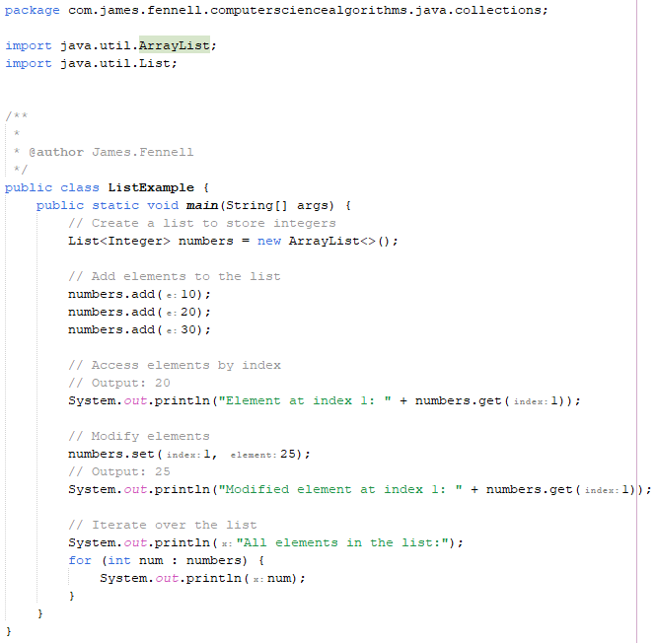
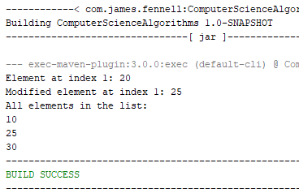
List Storing and Accessing Data Sequentially
A List is an ordered collection that allows duplicates and provides random access to elements. The most common implementation in Java is ArrayList.
ArrayList allows fast random access and is excellent when you need to store and retrieve data sequentially
You can add, modify, and access elements by their index
Performance degrades when frequently inserting or deleting elements from the middle of the list due to the need to shift elements
Other types of lists
LinkedList - Frequent insertions and deletions at both ends
CopyOnWriteArrayList - Thread-safe, read-heavy collections
Vector - Thread-safe dynamic arrays (legacy)

Slide 4
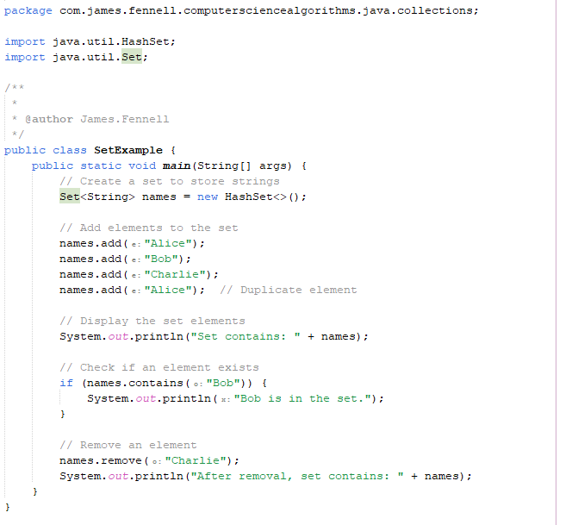
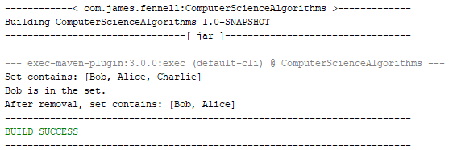
Set Ensuring Unique Elements
A Set is a collection that does not allow duplicate elements
One of the most commonly used implementations is HashSet
offers constant-time performance for basic operations like add, remove, and contains.
HashSet:
Adding "Alice" twice only results in one occurrence
Sets are useful when you need to ensure that each element appears only once
Hash-based operations (add, remove, contains) are very fast (constant time, O(1)).
Other types of Sets
TreeSet - Ordered set, sorted elements
LinkedHashSet - Set that maintains insertion order

Slide 5
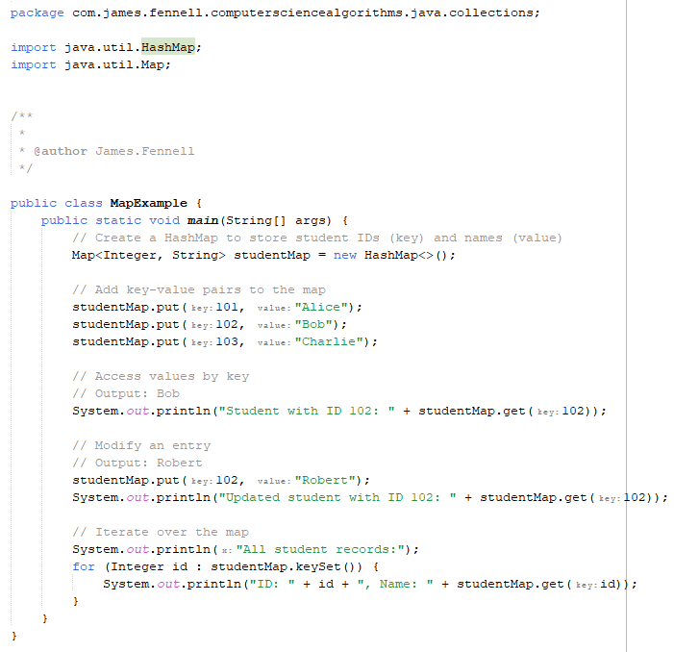
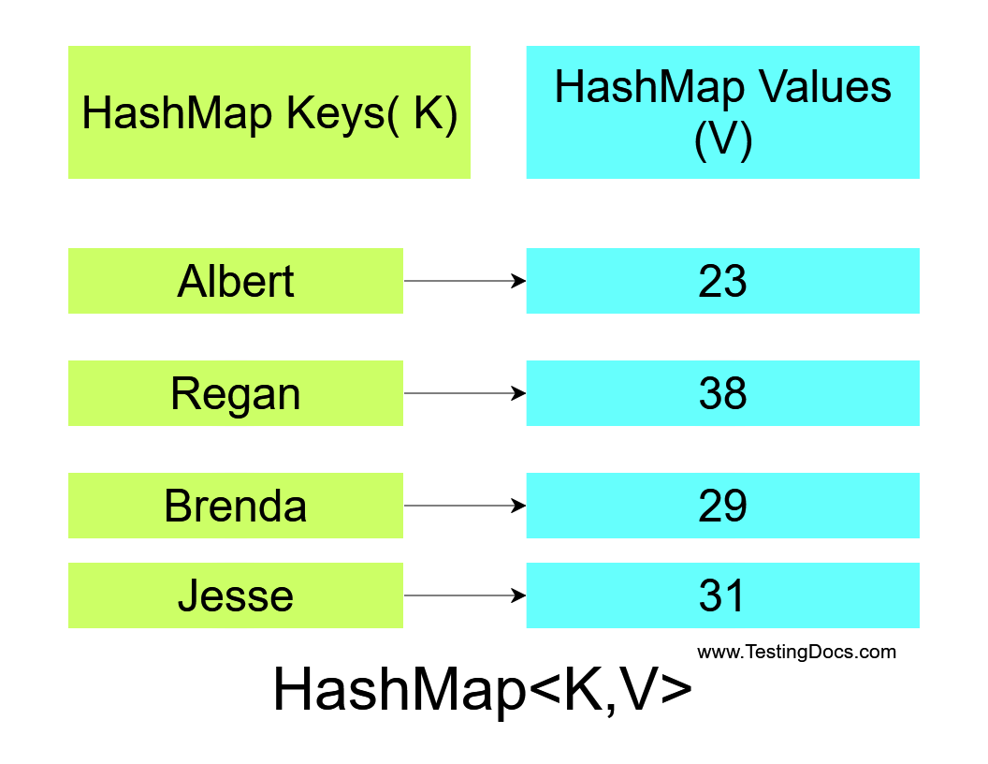
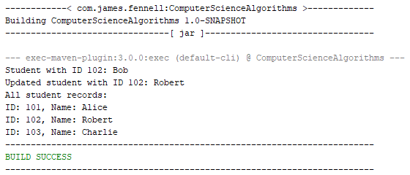
Map Key-Value Pairs
A Map is a collection that associates keys with values and allows quick lookups by key
HashMap is one of the most commonly used implementations
Each key must be unique, but values can be duplicated.
HashMap is useful for associative data where you need to map one value (key) to another (value) and provides constant-time performance for retrieval.
Other types of Maps
TreeMap - Sorted key-value pairs
LinkedHashMap - Insertion order or access-order map
ConcurrentHashMap - High-performance, thread-safe map

Slide 6
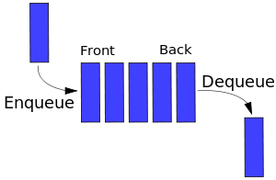
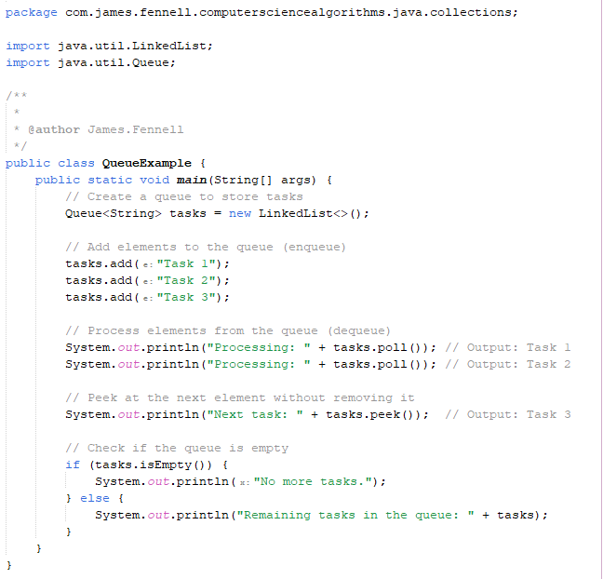
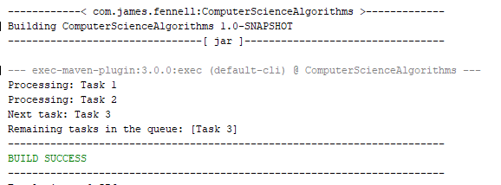
Queue First-In-First-Out (FIFO) Ordering
A Queue is a collection that processes elements in the order they are added (FIFO)
We use LinkedList as a queue implementation because it provides efficient insertion and deletion at both ends.
Methods like add() and poll() allow enqueueing and dequeueing elements efficiently
Commonly used in scheduling, job processing, and any task management system
Other types of Queues
ArrayDeque - Double-ended queue with better performance for both stack/queue ops
PriorityQueue - Elements ordered by priority (min-heap/max-heap)

Slide 7
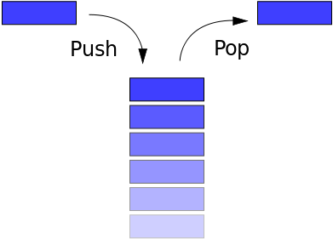
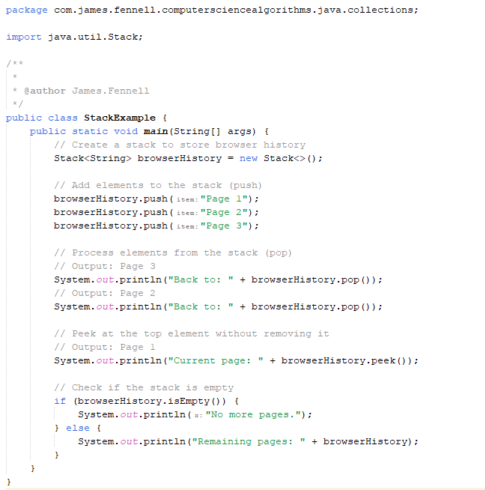
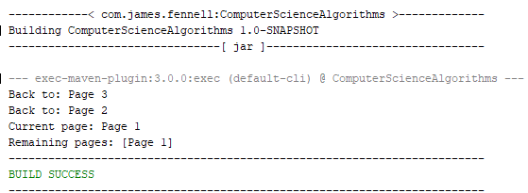
Stack Last-In-First-Out (LIFO) Ordering
Stack follows LIFO (Last-In-First-Out) ordering, making it ideal for operations where the most recent item should be processed first (e.g., undo operations, parsing)
Methods like push(), pop(), and peek() allow stack operations.
Other types of Stacks
ArrayDeque - Faster, modern stack implementation
LinkedList (as Stack) - Flexible stack behaviour with LinkedList

Slide 8
Summary
Collection Type | Best For | Key Characteristics
ArrayList | Storing data sequentially | Fast random access, allows duplicates, ordered by index
HashSet | Storing unique elements | No duplicates allowed, fast lookups, order is not guaranteed
HashMap | Mapping keys to values | Key-value pairs, fast retrieval by key, keys are unique
Queue | First-In-First-Out (FIFO) ordering | Elements processed in the order they are added, enqueue and dequeue operations
Stack | Last-In-First-Out (LIFO) ordering | Elements processed in reverse order of addition, used in tasks like undo operations

